Slide 1
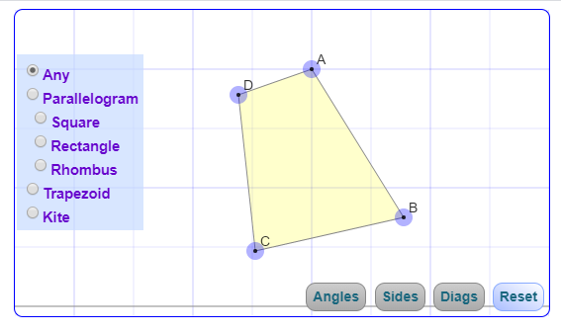
AREAS AND SHAPES
AREA: input box to show sq.cm
.
INFORMATION AREA. This section has to be populated with an image and definition of what is clicked. Show image from 3rd slide – figure and formula.
PERIMETER: input box to show cm
DRAWING AREA
ADD TRIANGLE TO MENU
PROPERTIES
LENGTH
BREADTH
HEIGHT
RADIUS
SIDE A
SIDE B
RESET

Slide 2
DESIGN TEAM
BUILD A GOOD IMAGE FOR EACH OF THE MENU BUTTONS. – SEE BELOW LIST.
YOU HAVE TO CREATE MENU BUTTON AND AN IMAGE FOR DISPLAY.
CLICK ON A BUTTON AND CLICK IN DRAWING AREA. IT SHOULD DRAW THE CORRESPONDING OBJECT.
OBJECTS NEEDED
DRAWING TOOLS
RULER,
PROTRACTOR
LINE
LEFT HAND MENU ITEMS
QUADRILATERAL, PARALLELOGRAM, SQUARE,RECTANGLE, RHOMBUS, KITE, TRAPEZIUM,
TRIANGLE, CIRCLE
PROGRAMMING NOTES:
CLICK ON A BUTTON.
THE INFORMATION AREA SHOULD BE POPULATED WITH FIGURE AND FORMULA FOR AREA AND PERIMETER. THE PROPERTY BOX SHOULD BE POPULATED WITH THE DIMENSIONS OF THE RECTANGLE THAT IS CREATED.
SEE SLIDES 3 AND 4 FOR FORMULA OF AREA AND PERIMETER
FOR THE DRAWING PART, USE THE INTERACTIVE QUADRILATERAL AND INTERACTIVE TRIANGLES.
OPEN ISSUE – ARE WE ABLE TO GET THE HEIGHT OF THE TRIANGLE OR QUADRILATERAL AUTOMATICALLY.
THE PARAMETERS SHOULD CHANGE AS THE USER DRAGS THE SHAPE OBJECT.
THE AREA BOX SHOULD HAVE A CHECKBOX TO ENABLE OR DISABLE DISPLAY. IF IT IS CLICKED, THE AREA VALUE SHOULD SHOW UP.
PROPERTIES:
FOR RECTANGLE – SHOW LENGTH, BREADTH
FOR TRIANGLE – SHOW BASE AND HEIGHT
FOR PARALLEOGRAM – SHOW BASE AND HEIGHT
FOR TRAPEZIUM – SHOW SIDE A, SIDE B AND HEIGHT
FOR RHOMBUS – SHOW LENGTHS OF DIAGONALS AND SIDE
FOR SQUARE – SHOW SIDE
FOR CIRCLE – SHOW RADIUS

Slide 3
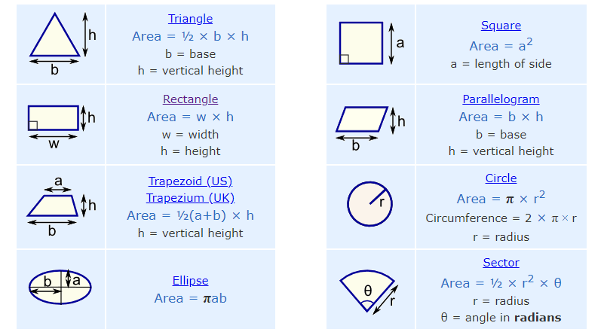
Do not show the arrows as above. Show diemnsions like this |------------------------|
For TRAPEZIUM, PARALLEOGRAM, SHOW A DOTTED LINE TO INDICATE HEIGHT OF THE FIGURE (h)

Slide 4
